Slide 1
2026 Mw 7.8 Mindanao (Philippines) Earthquake Risk Maps

Slide 2
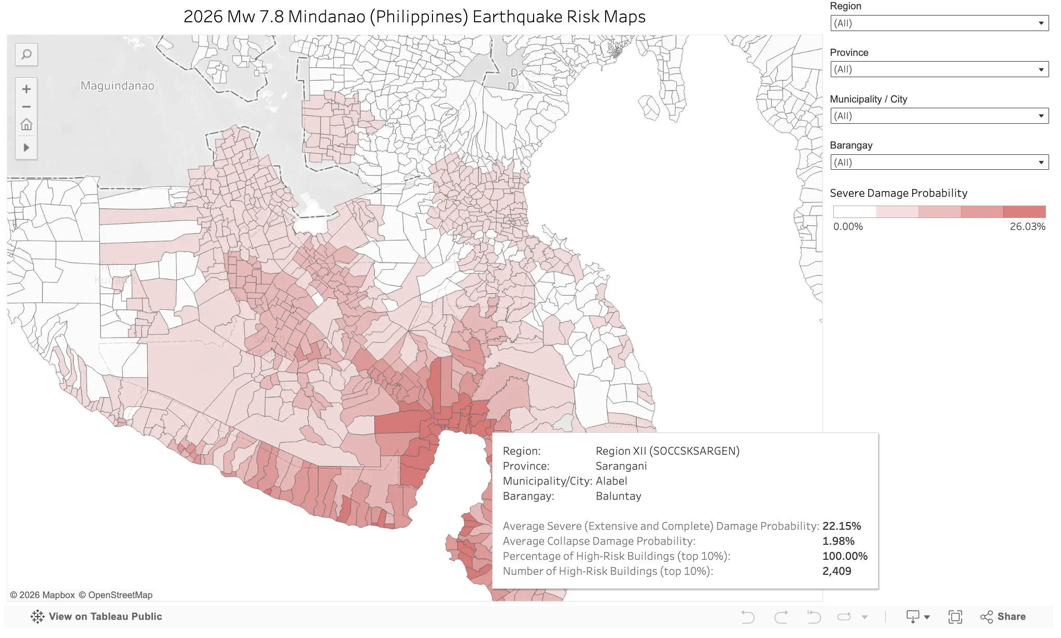

Slide 3
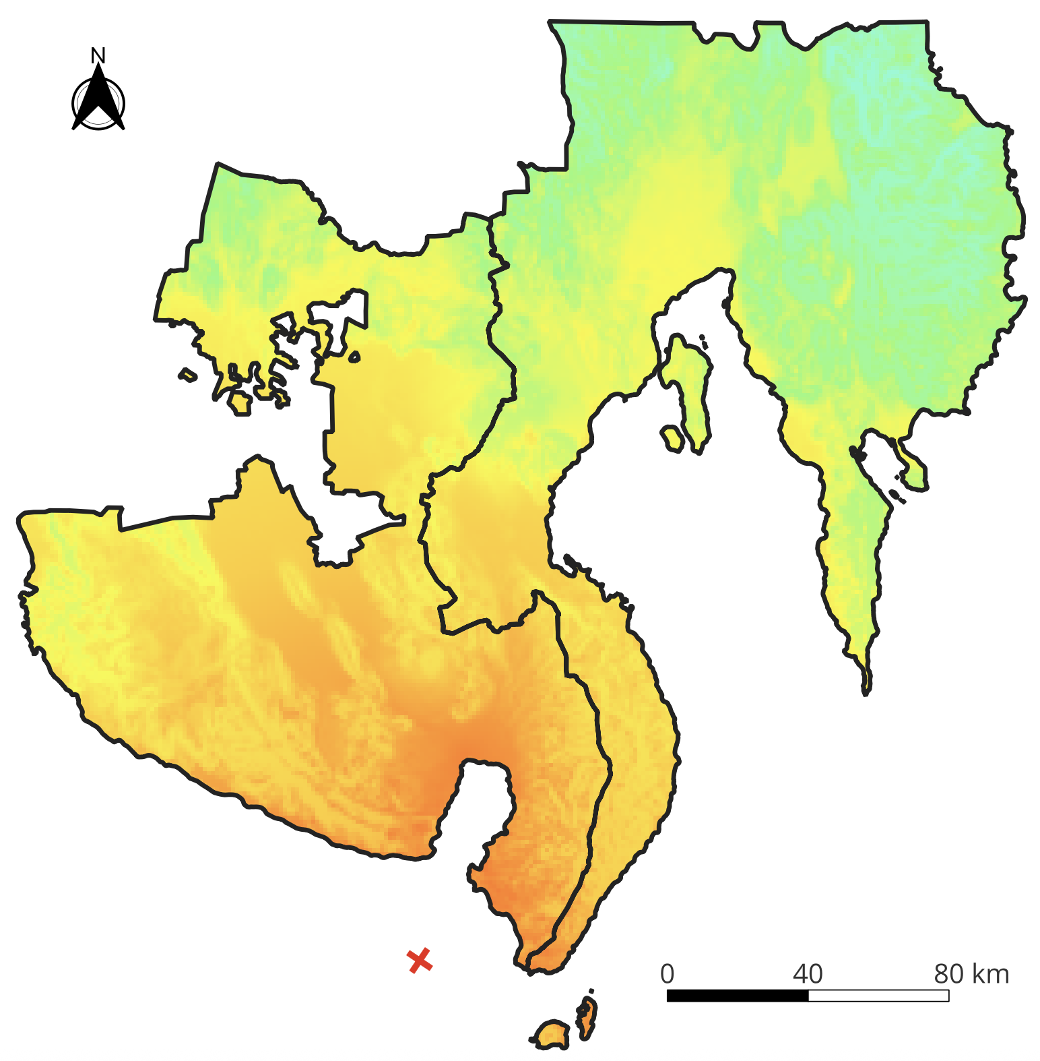

USGS Earthquake Intensity Map (MMI)

Slide 4
Average Severe (Extensive + Complete) Damage Probability

Slide 5
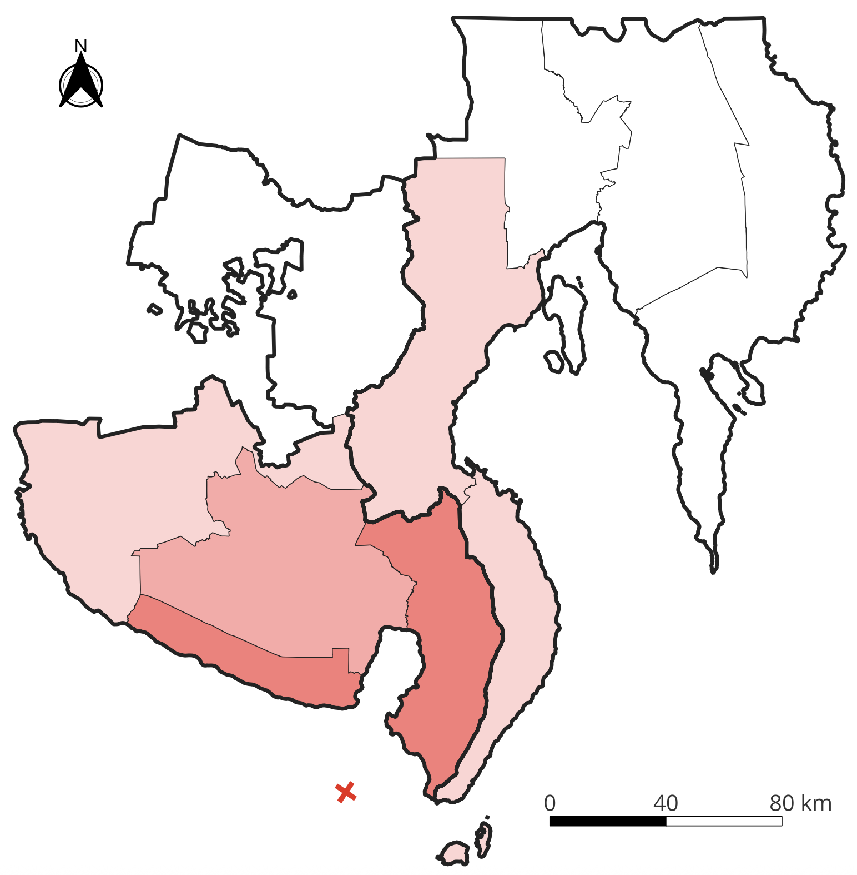
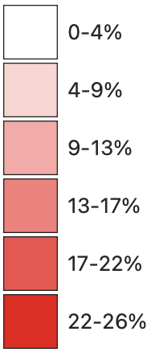
Average Severe (Extensive + Complete) Damage Probability

Slide 6
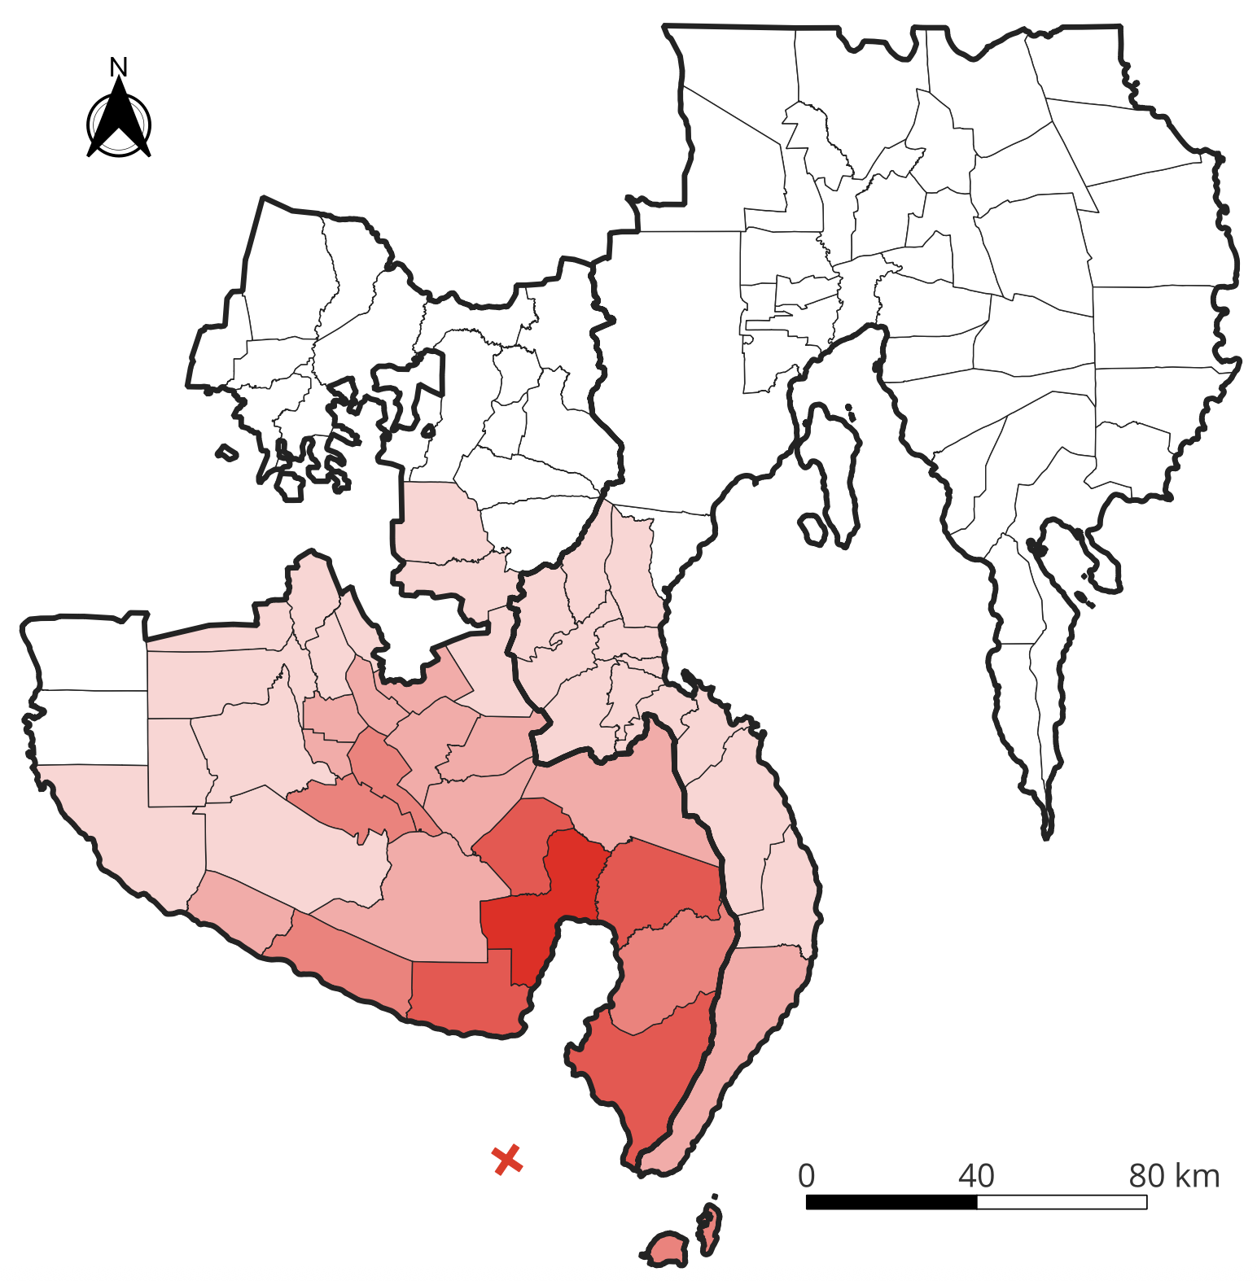
Average Severe (Extensive + Complete) Damage Probability

Slide 7
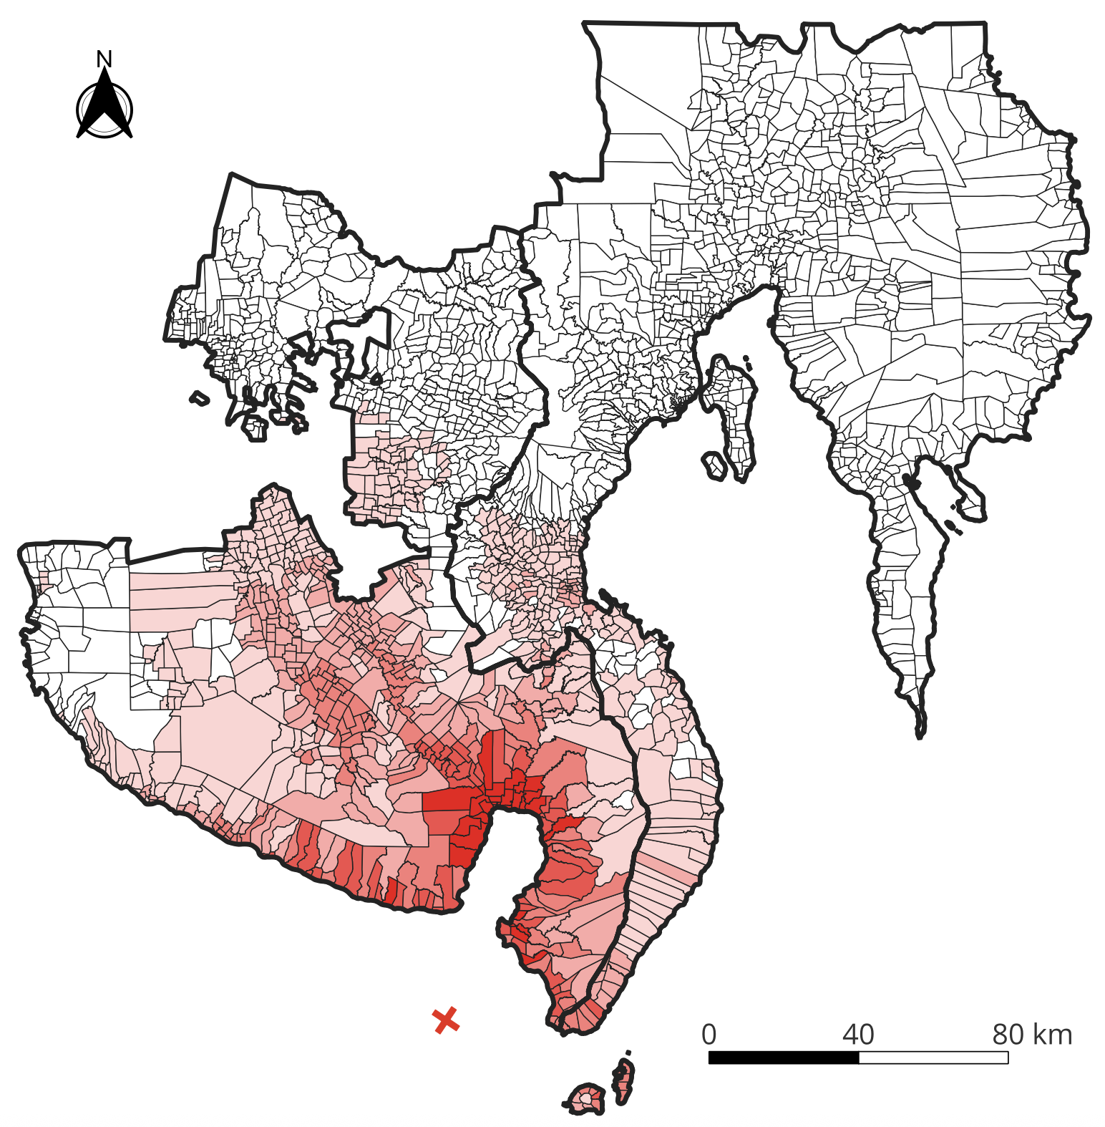
Average Severe (Extensive + Complete) Damage Probability

Slide 8
Average Collapse Damage Probability

Slide 9

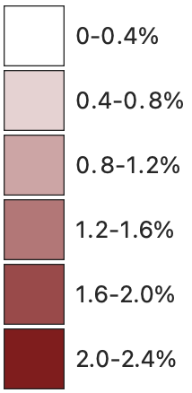
Average Collapse Damage Probability

Slide 10
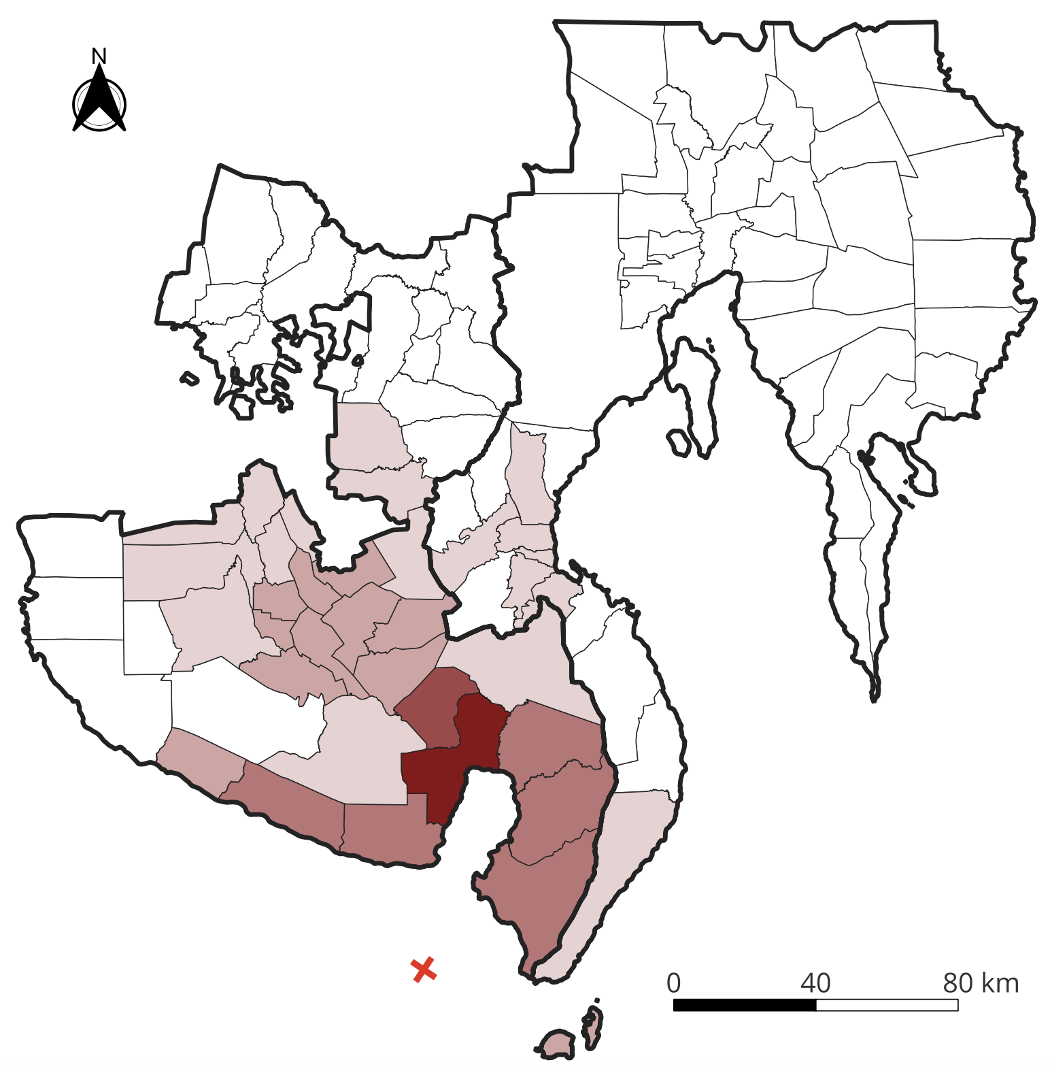
Average Collapse Damage Probability

Slide 11
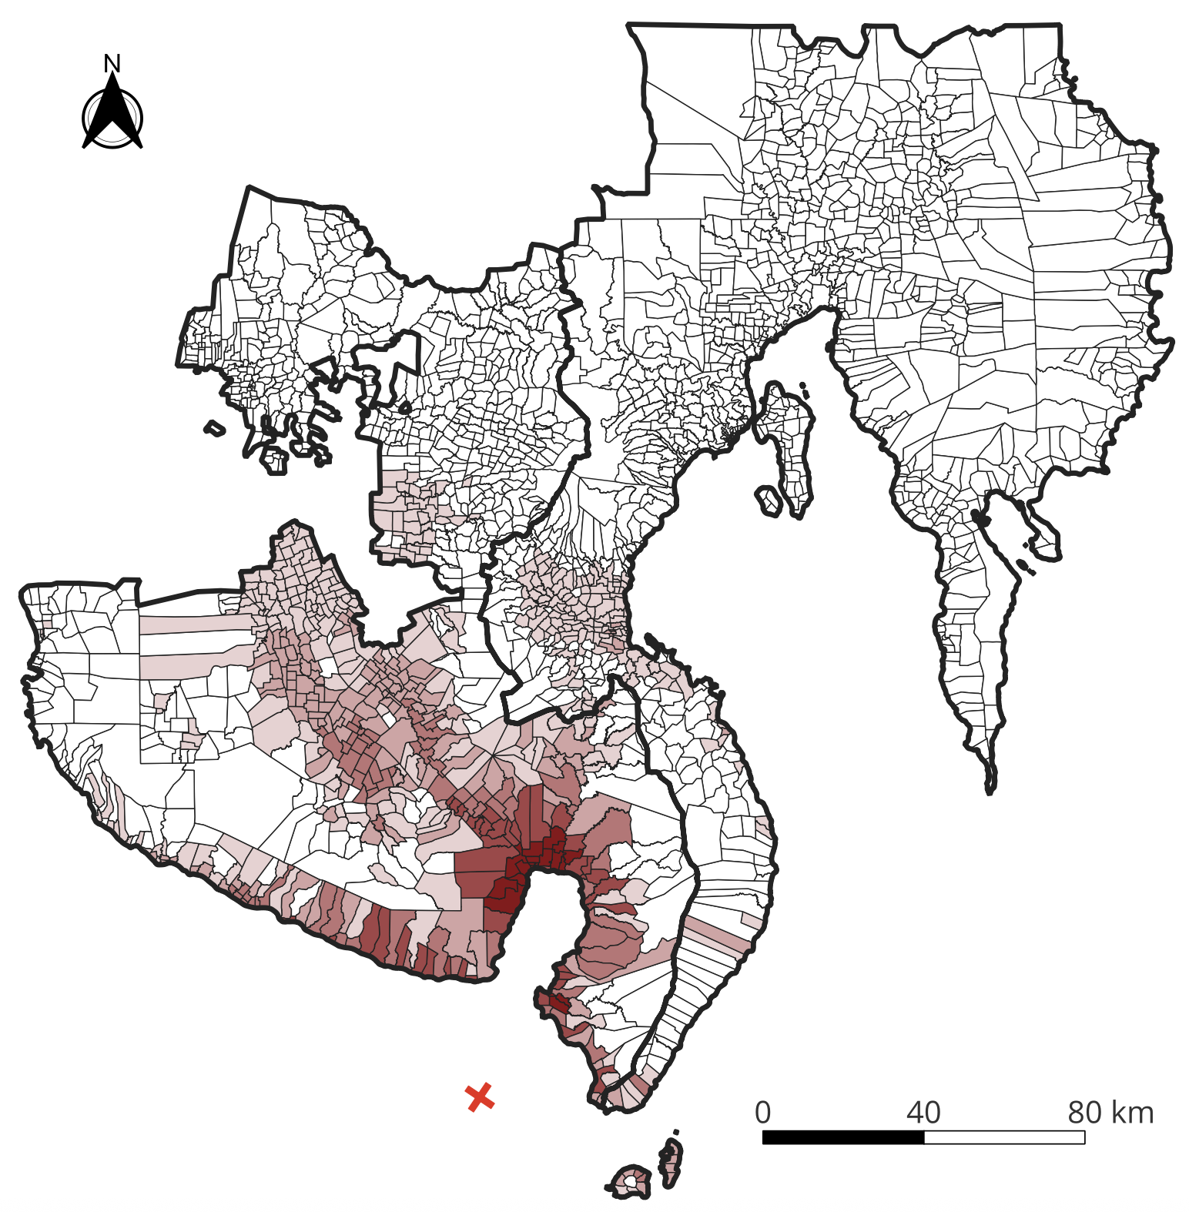
Average Collapse Damage Probability

Slide 12
High-Risk Building Concentration (Top 10%)

Slide 13
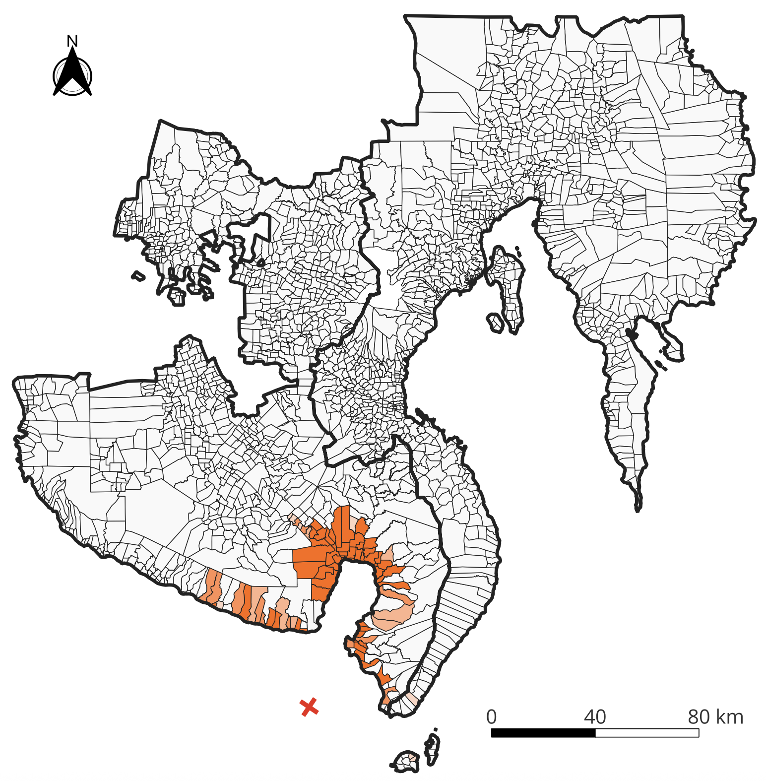
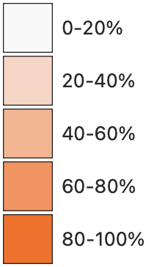
High-Risk Building Concentration (Top 10%)

